Slide 1

Personal News Digest Agent
Copilot Scenario Overview Deck
© 2026 Microsoft Corporation All rights reserved.
Notes:
CELA disclaimer
Terms displayed or discussed are for explanation/education only. Such terms may differ from your agreement.

Slide 2
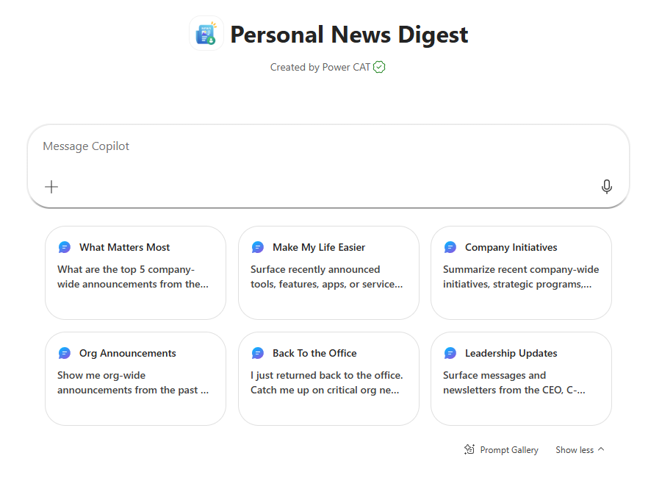
Personal News Digest Agent Summary
Agent Overview
Key Challenges
Filter high volumes of corporate broadcast communications across Outlook, Teams announcement channels, and SharePoint intranet into a personalized, role- and location-aware digest of what truly matters.
Employees overwhelmed by broadcasts across email, Teams, and intranet
Critical org-wide updates get lost in the noise
Mandatory policies, trainings, and deadlines are missed
Engagement and awareness drop under information overload
Business Outcomes
Accelerates revenue growth through faster strategic alignment
Saves time by replacing scanning with a curated digest
Boosts engagement with personalized, relevant updates
Sharpens responsiveness with timely announcements awareness
Technical Features
💬 Conversational access via Microsoft 365 Copilot
📋 Declarative agent grounded in mailbox, Teams Chats, SPO
🔍 Filters to high-impact, organization-wide broadcasts only
🌍 Role- and location-aware personalization; excludes peer/project chatter
© 2026 Microsoft Corporation All rights reserved.
Notes:
CELA disclaimer
Terms displayed or discussed are for explanation/education only. Such terms may differ from your agreement.

Slide 3
Table of Contents
Overview
Persona Example
User Journey Scenario Example
Solution Screenshots
Demo Prompts
Notes:
CELA disclaimer
Terms displayed or discussed are for explanation/education only. Such terms may differ from your agreement.

Slide 4
Personal News Digest is a declarative agent that intelligently filters Microsoft 365 communications to surface only high-impact, organization-wide broadcasts from the last 15 days.
It delivers a concise, role- and location-aware digest that prioritizes relevance and organizational impact. By excluding peer, manager, and project conversations, it ensures employees stay informed with minimal distraction and clear actions.
Overview
© 2026 Microsoft Corporation All rights reserved.

Slide 5


Persona Example
Two core personas: the employee scanning for what matters and the manager cascading critical updates downstream.
Employee
People Manager
Informed worker
Cascader
Wants signal, not noise, from corporate broadcasts
Needs clarity on mandatory policies, incidents, & actions
Cascades critical updates to direct reports
Needs concise, role-relevant org-wide updates
Typical Ask
Typical Ask
I just returned back to the office. Catch me up on critical org news since the start of my time off.
What are the top 5 company-wide announcements from the past week, tagged by Critical, Important, and FYI. Include the sender and date for each announcement
Key Challenges Addressed
Broadcast overload across email, Teams, and intranet; critical updates get lost; mandatory policies and deadlines are missed.

Slide 6


User Journey
From a single prompt to a personalized, prioritized digest, the agent filters out noise and surfaces only what matters at an organizational level.
1
Trigger
2
Evaluation
3
Output
User asks the agent in Copilot, e.g., “What are the most important company updates I should know?” or “Give me my personalized news digest for the last 2 weeks”
Agent scans Outlook, Teams announcement channels, and SharePoint intranet from the last 14 days, filtering out peer, manager, and project conversations.
A personalized, role- and location-aware digest
Backbone
Microsoft 365 Graph signals
Broadcast filtering logic
Role- and location-aware personalization

Slide 7







High Level Agent Architecture
Personal News Digest Agent
How it works
User interacts with the agent via Microsoft 365 Copilot
Declarative agent scans Emails, Teams Chats & Meetings, SharePoint & People
Agent filters to high-impact, org-wide broadcasts
Returns a role- and location-aware digest with clear actions
Microsoft Teams
Outlook
SharePoint
1
2
End User
Personal News Digest Agent
Teams
People
Developer
Maker
Knowledge Worker
Declarative Agent
Microsoft 365 Copilot
Knowledge Sources

Slide 8
Agent Solution Screenshots
© 2026 Microsoft Corporation All rights reserved.
Notes:
Title: Click-through demo
Now, let’s see how that all comes together for our key persona.
CELA disclaimer
Terms displayed or discussed are for explanation/education only. Such terms may differ from your agreement.

Slide 9
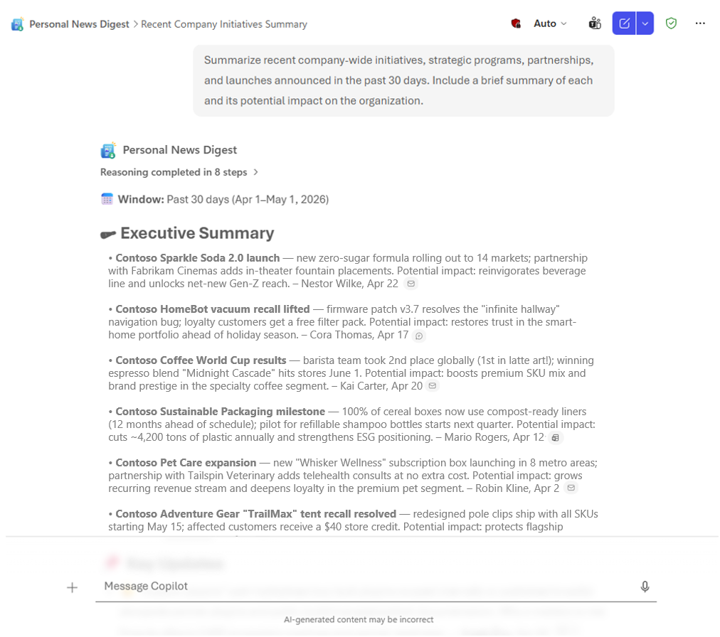
Agent Snapshot

Slide 10
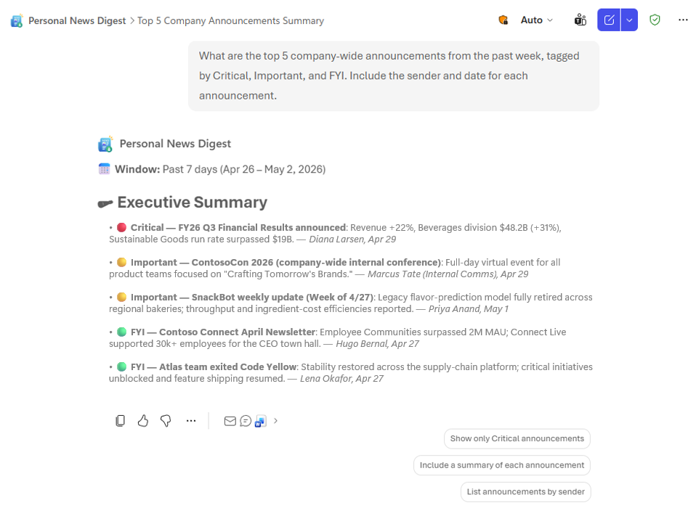
Agent Snapshot

Slide 11
Demo Prompts & Eval Set
Notes:
CELA disclaimer
Terms displayed or discussed are for explanation/education only. Such terms may differ from your agreement.

Slide 12
Demo Prompts & Eval Set
ID | Test Scenario | Prompt | Expected Result
1 | What Matters Most | “What are the top 5 company-wide announcements from the past week, tagged by Critical, Important, and FYI. Include the sender and date for each announcement.” | Returns the top 5 org-wide announcements from the last 7 days, each tagged 🔴/🟡/🟢 with sender and date.
2 | Make My Life Easier | “Surface recently announced tools, features, apps, or services I could start using to make my work easier — include what it does, who it's for, and how to get started.” | Returns newly announced tools/features with what it does, who it's for, and a get-started link.
3 | Company Initiatives | “Summarize recent company-wide initiatives, strategic programs, partnerships, and launches announced in the past 30 days. Include a brief summary of each and its potential impact on the organization.” | Returns major initiatives from the past 30 days with a brief summary and an org-impact statement per item.
4 | Org Announcements | “Show me org-wide announcements from the past 30 days, deduplicated across Outlook + Teams + SharePoint + Newsletters, with a 'why it matters to me' line.” | Returns deduplicated org-wide announcements with priority tag, source attribution, and a personal “Why it matters to me” line.
5 | Back to the Office | “I just returned back to the office. Catch me up on critical org news since the start of my time off.” | Resolves the OOO window from Outlook calendar and returns a digest of critical org news for that exact range.
6 | Leadership Updates | “Surface messages and newsletters from the CEO, C-suite, or skip-levels in the past 30 days — include key quotes.” | Returns only the From Leadership section with Exec Voice items and grounded key quotes ≤ 20 words.
7 | Manager Announcements | “What announcements made by my manager in the past 14 days should my team pay attention to? Summarize key actions my team should take.” | Returns direct-manager announcements (resolved via People knowledge) plus an Action Required list with clear next steps and deadlines.
8 | Policy Action | “List recent policy changes that require employee action, including deadlines and links to the official policy.” | Returns policy changes requiring action, each with a deadline and link to the authoritative SharePoint policy page.
9 | Operational Alerts | “Are there active incidents or planned outages I should know about?” | Returns only operational alerts — status (active/resolved/planned), service, impact, source — or the exact empty-state string if none.
10 | Job-Impacting Changes | “What recent organizational or policy changes most affect my job?” | Returns a personalized digest of org and policy changes filtered for job impact, each with a “Why it matters to me” line tied to the user's role.

Slide 13
Thank You
Notes:
CELA disclaimer
Terms displayed or discussed are for explanation/education only. Such terms may differ from your agreement.

